Slide 1
Absolute Light Yield Measurement
Ayub Sherif

Slide 2
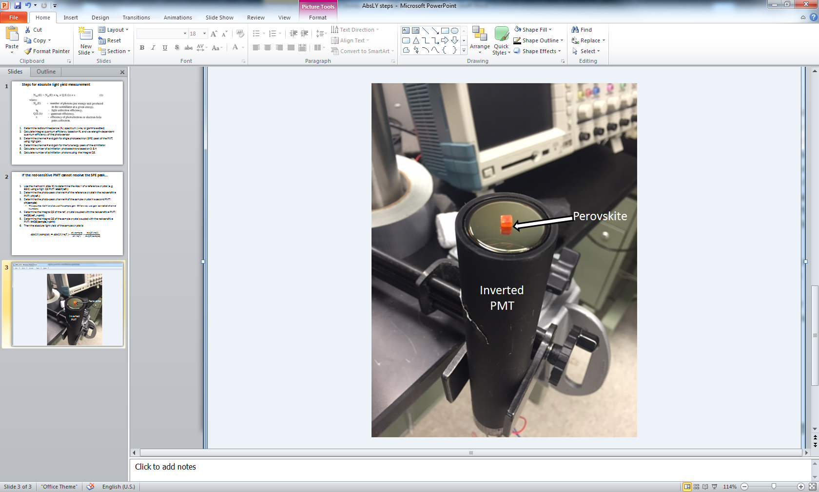
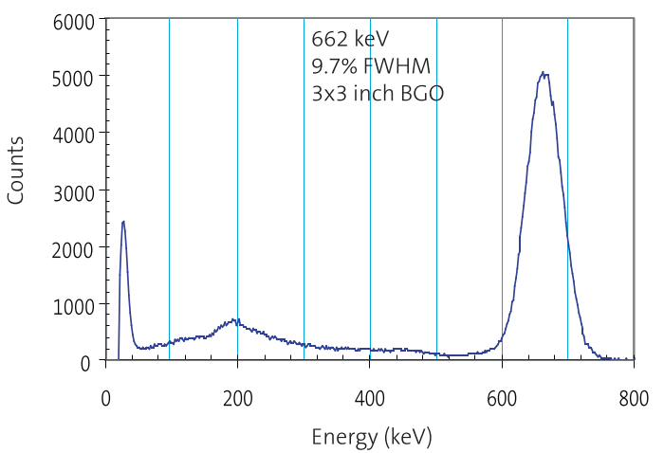
Objective: Determine Absolute Light Output from Perovskite under Gamma Irradiation
Aluminum Foil Cap
Teflon Tape
Perovskite
PMT
Notes:
The pulse height spectrum of a 3” diameter, 3” high BGO crystal when irradiated with 662 keV γ-rays

Slide 3
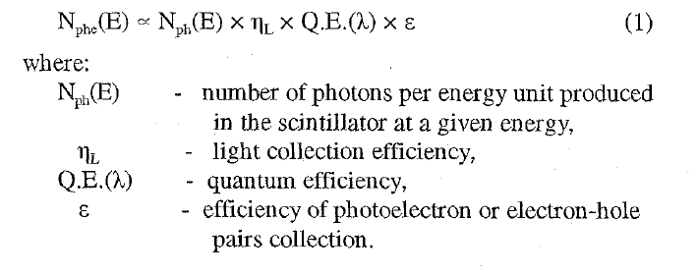
Procedure:
Determine radioluminescence (RL) spectrum (x-ray or gamma excited)
Calculate integral quantum efficiency based on RL and wavelength-dependent quantum efficiency of the photo-sensor
Determine channel # and gain for single photoelectron (SPE) peak of the PMT, using high gain
Determine channel # and gain for the full energy peak of the scintillator.
Calculate number of scintillation photoelectrons based on 3 & 4
Calculate number of scintillation photons using the integral QE.

Slide 4
PMT
CPU
Amplifier
ADC
15V Power Supply
Gain
Time Constant
Pole Zero

Slide 5
Aluminum Foil Cap
Teflon Tape
PMT
Perovskite

Slide 6
Steps for absolute light yield measurement
Slide Courtesy of Dr. Kan Yang
Determine radioluminescence (RL) spectrum (x-ray or gamma excited)
Calculate integral quantum efficiency based on RL and wavelength-dependent quantum efficiency of the photo-sensor
Determine channel # and gain for single photoelectron (SPE) peak of the PMT, using high gain
Determine channel # and gain for the full energy peak of the scintillator.
Calculate number of scintillation photoelectrons based on 3 & 4
Calculate number of scintillation photons using the integral QE.

Slide 7
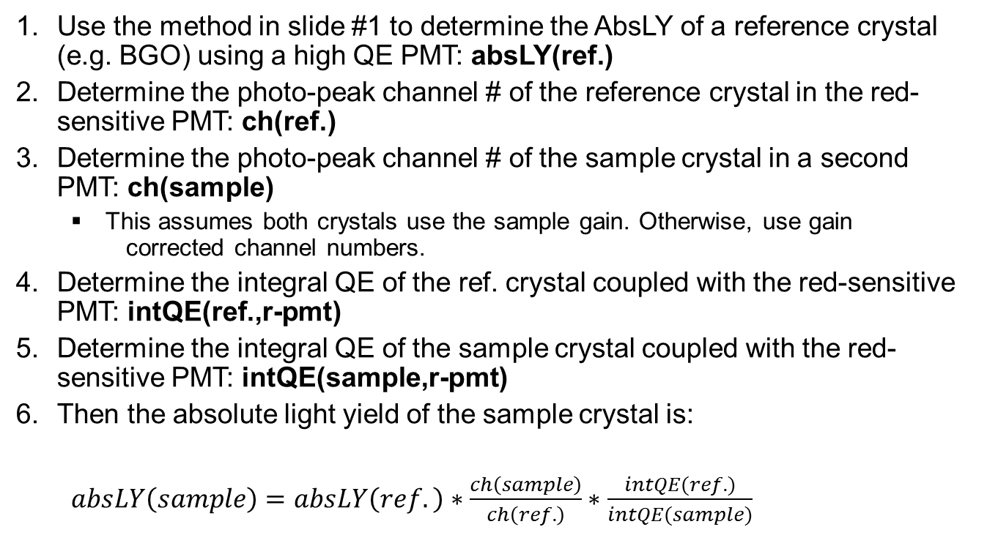
If the red-sensitive PMT cannot resolve the SPE peak…
Slide Courtesy of Dr. Kan Yang
Use the method in slide #1 to determine the AbsLY of a reference crystal (e.g. BGO) using a high QE PMT: absLY(ref.)
Determine the photo-peak channel # of the reference crystal in the red-sensitive PMT: ch(ref.)
Determine the photo-peak channel # of the sample crystal in a second PMT: ch(sample)
This assumes both crystals use the sample gain. Otherwise, use gain corrected channel numbers.
Determine the integral QE of the ref. crystal coupled with the red-sensitive PMT: intQE(ref.,r-pmt)
Determine the integral QE of the sample crystal coupled with the red-sensitive PMT: intQE(sample,r-pmt)
Then the absolute light yield of the sample crystal is:
$absLY\left(sample\right)=absLY\left(ref.\right)∗\frac{ch\left(sample\right)}{ch\left(ref.\right)}∗\frac{intQE(ref.)}{intQE(sample)}$

